Slide 1
VA Pharmacy Data HERC Data Bootcamp
26 October 2023
Mark Bounthavong
mark.bounthavong@va.gov
Updated slides (link)

Slide 2
Disclosures and Disclaimers
The author has no relevant financial or nonfinancial relationships to disclose. During the development, analysis, and preparation of this presentation, the author was an employee of the Veterans Health Administration, U.S. Department of Veterans Affairs.
The views and opinions expressed in this presentation are those of the author and do not necessarily reflect the official policy or position of any agency of the U.S. government.

Slide 3
Objectives
Describe the different types of VA Pharmacy Data
Describe the elements for each VA Pharmacy Data
Learn how to get access to the data

Slide 4
Common Pharmacy Data Sources at the VA
VA Pharmacy Data can be located at:
Pharmacy Benefits Management (PBM)
Managerial Cost Accounting (MCA) Pharmacy (PHA) National Data Extract (NDE)
Corporate Data Warehouse (CDW)
Observational Medical Outcomes Partnership (OMOP)

Slide 5
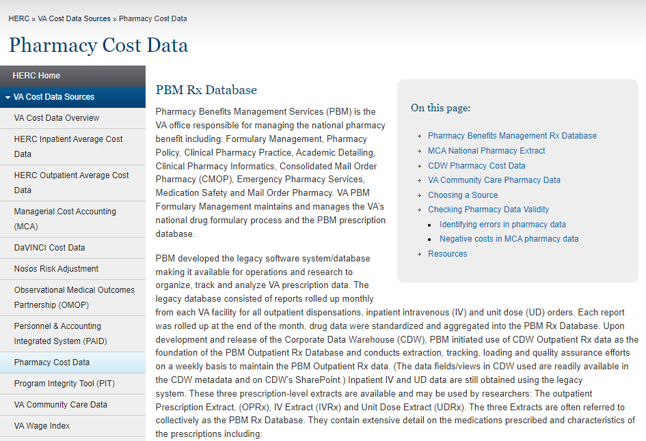
HERC resources
https://www.herc.research.va.gov/include/page.asp?id=pharmacy

Slide 6
Definitions
Pharmacy Product
Includes prescriptions, over the counter (OTC) medications, supplies issued by pharmacy
All products dispensed or paid for by the VHA pharmacy

Slide 7
Definitions
Patient Identifiers
PatientICN – Patient Integration Control Number (Patient Identifier)
PatientSID– Patient Surrogate Identifier (Patient Record Identifier)
SSN – Social Security Number
ScrSSN – Scrambled SSN
CDWwork.SPatient.SPatient
PatientSID
PatientICN
PatientSID
PatientSID

Slide 8
VA Pharmacy Benefits Management (PBM)
Pharmacy Benefits Management (PBM)
PBM Services is a program office aligned under the Office of Patient Care Services, which is comprised of senior pharmacy leaders with expertise in clinical pharmacy practice, prescription benefits management, VA regulations, and federal laws related to pharmacy operations. This program office works with the MAP and VPE committees to facilitate and coordinate the VANF process.
It is VHA policy that the formulary management process provides pharmaceutical and supply products of the highest quality and best value, while ensuring the portability and standardization of this benefit to all eligible Veterans. The VANF is the only drug formulary authorized for use in VHA and the use of VISN formularies or local drug formularies at individual VA medical facilities is prohibited.
VHA Handbook 1108.08

Slide 9


VA PBM Pharmacy Data
VA PBM Pharmacy Data
Pharmacy Benefits Management (PBM) Strategic Health Group: Check data for quality
CDW
PBM Local Extracts:
Prescription
Unit Dose
IV
(PBM Database Extraction Software)
VistA File—Local
>130 systems
PBM Database (National)
Notes:
Not accurate anymore, Wrobel gets this from CDW even for UD and IV Raw. Only stations that still use the VistA PBM Extracts are the admin HAC, HEC, and CMOPs. Need both.

Slide 10
VA PBM Pharmacy Data
VA PBM Pharmacy Data
https://vaww.vhadataportal.med.va.gov/Data-Sources/PBM-Database
Available dates: 1999 to present
All VA patients who ever had a prescription from the VA Pharmacy
Inpatient and Outpatient
Consolidated Mail Outpatient Pharmacy (CMOP)
Extracted from VistA → PBM database*
(*) Also extracted from the CDW
Getting access:
https://vaww.vhadataportal.med.va.gov/DataSources/PBMDatabase.aspx
[Custom extracts are developed for each research]

Slide 11
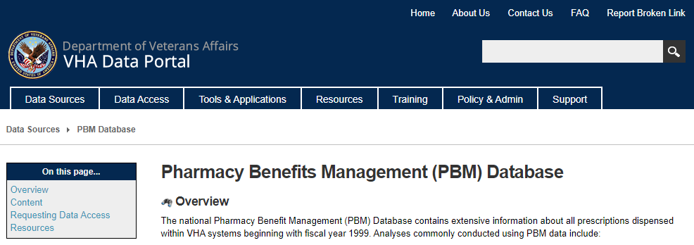
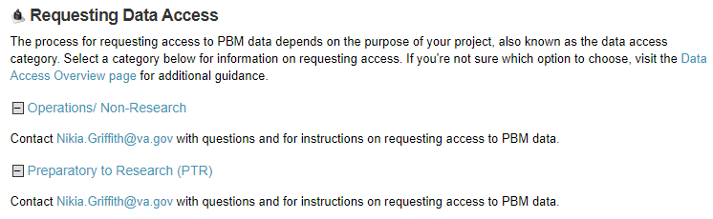
VA PBM Pharmacy Data

Slide 12
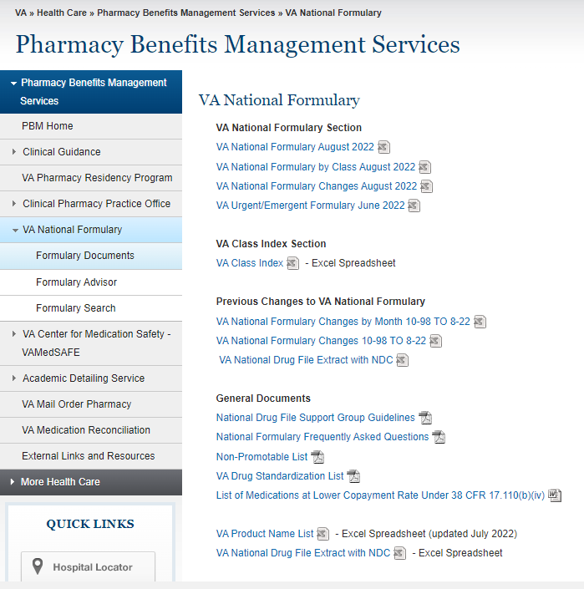
VA PBM Pharmacy Data
National Drug file
Standardization of the Local Drug Files
Dosage Form
Strength
Unit
Package Size and Type
Manufacturer’s Trade Name
National Drug Code
VA drug Class
VA National Formulary
List of all medications that providers can order at the VA
VA Drug Class
Formulary Status / Restrictions
https://www.pbm.va.gov/PBM/NationalFormulary.asp
Notes:
Database form is in UMLS or internally.

Slide 13
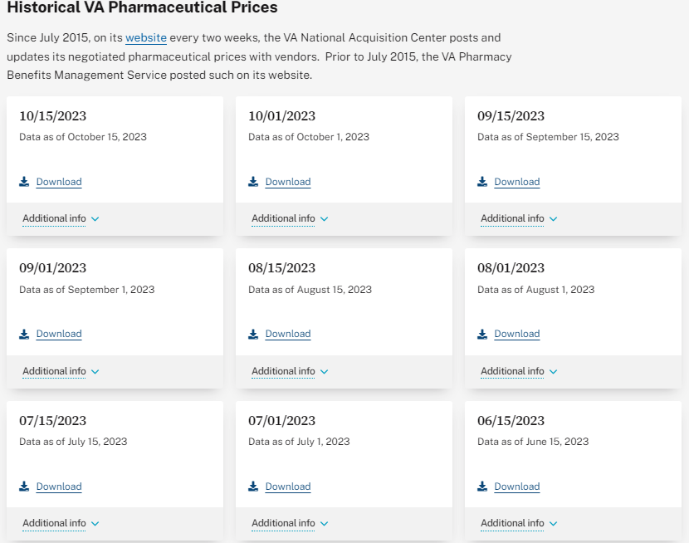
VA PBM Pharmacy Data
Historical Prices for Pharmacy Products
https://department.va.gov/administrations-and-offices/acquisition-logistics-and-construction/freedom-of-information-act-requests/#toc_Historical_VA_Pharmaceutical_Prices

Slide 14
MCA PHA NDE
Managerial Cost Accounting Pharmacy National Data Extract (MCA PHA NDE)
VistA File—Local
Outpatient
IV
Unit Dose packages
MCAO DSS databases
MCA National Data Extracts
MCAO, Managerial Cost Accounting Office
Notes:
Some records in the inpatient and outpatient MCA pharmacy data may contain negative quantity and/or cost values for prescriptions because all three packages allow returns to stock.

Slide 15
MCA PHA NDE
MCA PHA NDE site
http://vaww.vhadataportal.med.va.gov/DataSources/MCA(formerlyDSS)NDEs.aspx
Available dates: 2005 to present
DSS Schema
Pharmacy cost and workload data at the level of the individual prescription for all inpatient and outpatient activities
Managerial Cost Accounting Office (MCAO)
Do not contain dosing instructions / dispensing unit
Getting access
http://vaww.vhadataportal.med.va.gov/DataAccess/HealthcareOperationsRequestProcess.aspx

Slide 16
MCA PHA NDE
MCA PHA NDE contains the following column elements
Patient Characteristics – Who was the RX prescribed for?
Provider Characteristics – Who prescribed the RX
Medication Characteristics – What RX was prescribed?
Cost Elements – What were the dispensing and costs of RX?
Event Dates – When was RX prescribed?
Patient Care Setting – Where the RX was provided?
Pharmacy Location – Where was the RX filled?
Notes:
With facility adjustment, not just drug cost! Act vs Disp!

Slide 17
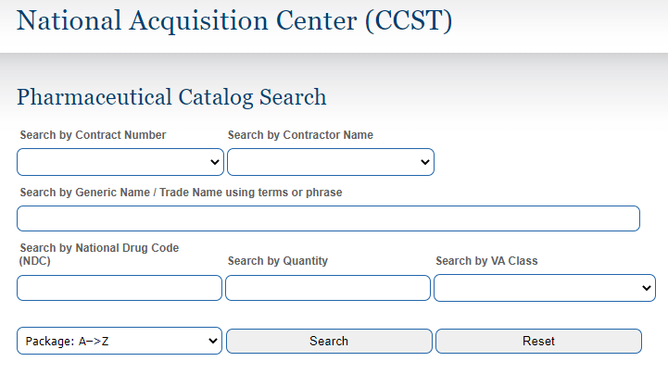
Additional Information about Pharmacy Cost
Pharmacy Actual Acquisition Cost Data
We are not allowed to disclose the actual acquisition costs of the drugs
If we need to provide information about a specific unit price, it is recommended to use the Federal Supply Schedule (FSS) from the National Acquisition Center (NAC) Pharmaceutical Catalog:
https://www.vendorportal.ecms.va.gov/nac/Pharma/List

Slide 18
Pharmacy Data Nuances
dispcost
Prior to 2003, the dispcost was the average across the number of prescriptions
For instance, if a patient had three prescriptions, the dispcost was divided by three
In 2003, the dispcost was changed to reflect the actual labor associated with each prescription based on their complexity

Slide 19
VA Corporate Data Warehouse Pharmacy Data
VA CDW Pharmacy Data
Updated nightly
VistA File—Local
> 130 systems
Regional Data Warehouses
(nightly)
Corporate Data Warehouse
OutPatient
BCMA
BCMA, Bar Code Medication Administration

Slide 20
VA CDW Pharmacy Data
VA CDW Pharmacy Data
Available date: 1999 to Present
Security group: CDW_FULL
Main domains:
Pharmacy Outpatient
Pharmacy Bar Code Medication Administration (BCMA)
NonVAMeds
RAW UD/IV
PIT, Fee
Getting access
http://vaww.vhadataportal.med.va.gov/DataAccess/HealthcareOperationsRequestProcess.aspx

Slide 21
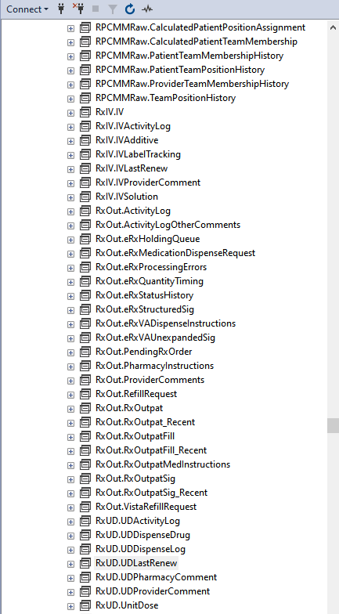
Microsoft SQL Server Management Studio
CDWWork database
RxOut.RxOutPat
RxOut.RxOutPatFill
RxOut.RxOutSig

Slide 22
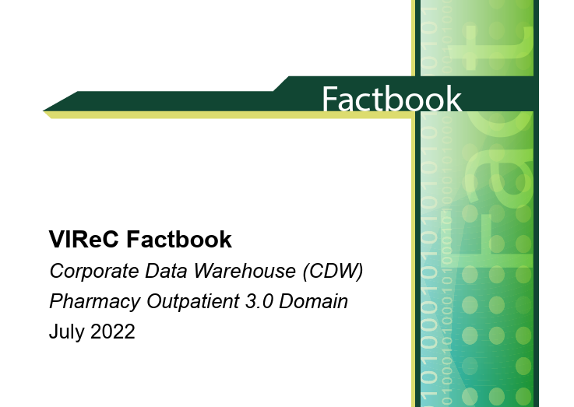
Microsoft SQL Server Management Studio
FB-CDW-Pharmacy-Outpatient-Domain.pdf (va.gov)

Slide 23
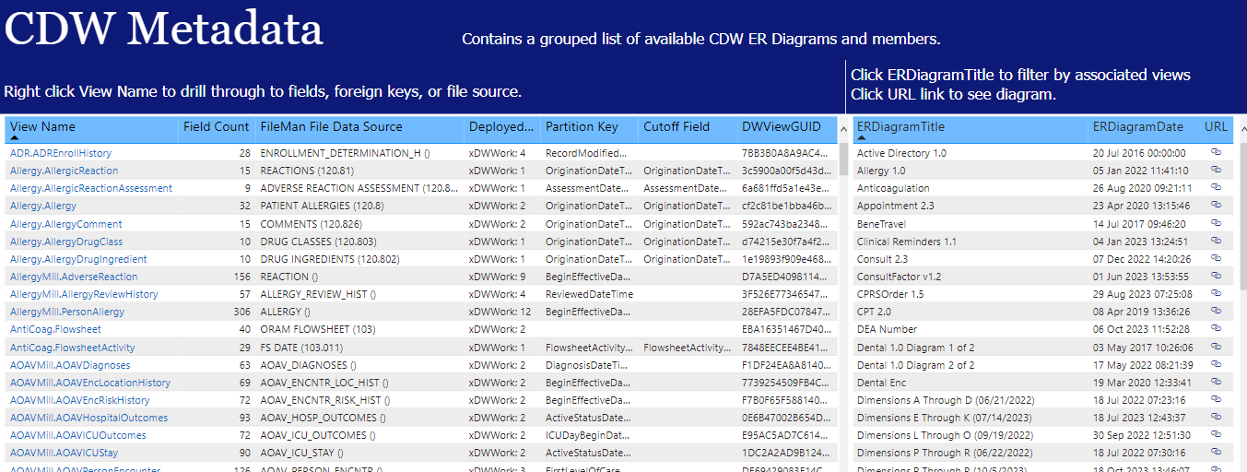
VA CDW Pharmacy Data—Metadata Report
CDW Metadata
Pharmacy BCMA
Pharmacy Outpatient
CDW Metadata - Power BI Report Server (va.gov)

Slide 24
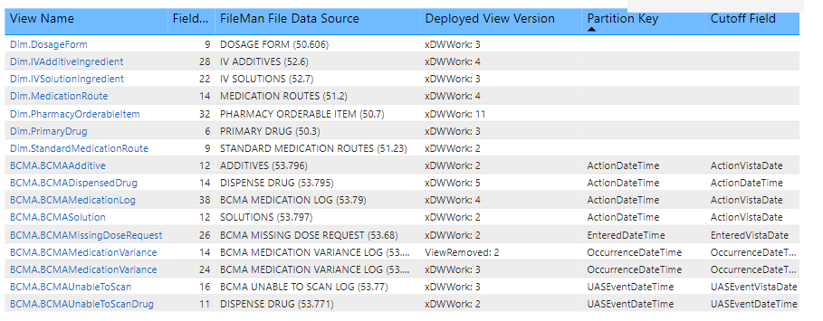
VA CDW Pharmacy Data—BCMA
Pharmacy BCMA 2.0
CDW Metadata New - Power BI Report Server (va.gov)

Slide 25
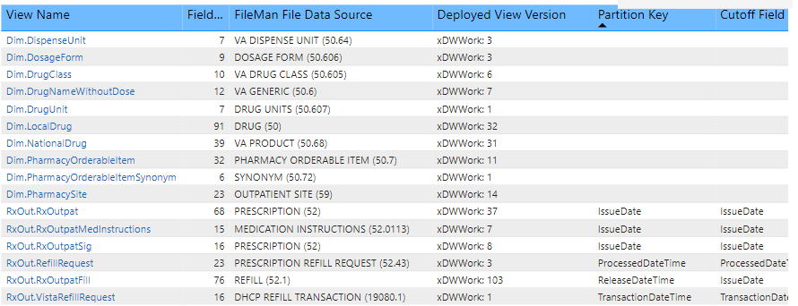
VA CDW Pharmacy Data—Outpatient
Pharmacy Outpatient 3.0

Slide 26
VA CDW Pharmacy Data—NonVAMed
Non-VA Medications
[NonVAMed].[NonVAMed]
Column name | Description
PharmacyOrderableItemSID | ID of the order number
DiscontinuedDateTime | Date patient stopped taking the medication
DocumentedDateTime | Date non-VA medication was entered into patient's profile
Dosage | The dosage of the non-VA medication that is being taken by the patient
MedicationRoute | The route by which the patient takes the non-VA medication
NonVAMedComments | Comments related to the non-VA medication order
Schedule | Frequency or schedule for when patients takes the medication
StartDateTime | The date the patient started taking the non-VA medication

Slide 27
VA CDW Pharmacy Data
CDW SharePoint site (New BISL site):
https://dvagov.sharepoint.com/sites/OITBISL/SitePages/BISLHome.aspx
CDW Metadata*
https://dvagov.sharepoint.com/sites/OITBISL/MetaData/
CDW Metadata Report*
https://vaww.pbi.cdw.va.gov/PBI_RS/powerbi/GPE/BISL_ArchReports/Public/PBI/CDW%20Metadata
*Migration to SharePoint is now complete

Slide 28

Observational Medical Outcomes Partnership (OMOP)
OMOP
CDW
VINCI OMOP
(ETL process)
OMOP

Slide 29
Observational Medical Outcomes Partnership (OMOP)
OMOP is only available for researchers and not for operations
OMOP contains the same information from the CDW Pharmacy Data but standardized using RXNORM
OMOP can be mapped to the CDW Pharmacy Data for additional details (e.g., SIG)

Slide 30
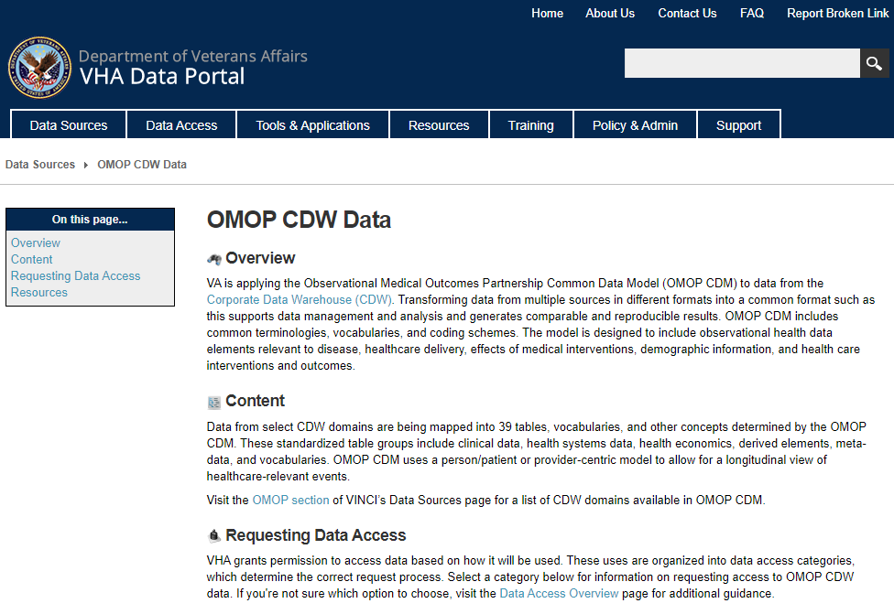
Observational Medical Outcomes Partnership (OMOP)
Requesting access to OMOP (link)

Slide 31
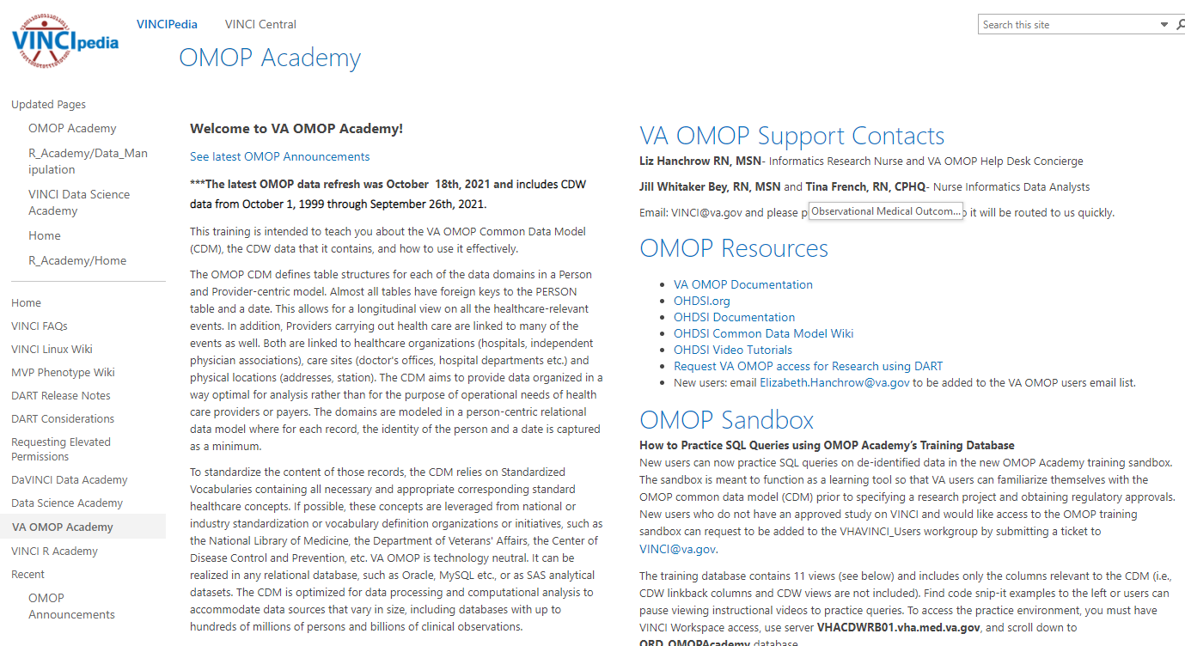
Observational Medical Outcomes Partnership (OMOP)
OMOP Academy (link)

Slide 32
Summary
 | VA PBM Pharmacy Data | MCA PHA NDE | CDW Pharmacy | OMOP
Data availability | 1999 | 2005 | 1999 | 1999
Drug costs | X | X | X | Map to CDW
Labor costs |  | X
Sig (direction) | X |  | X | Map to CDW
Unit dispensing | X |  | X | Map to CDW

Slide 33
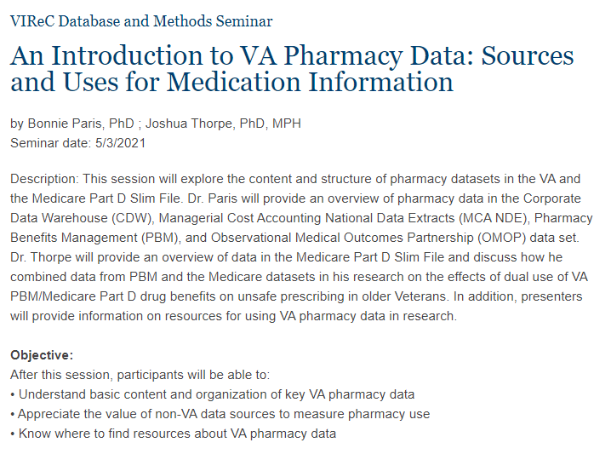
Resources
An Introduction to VA Pharmacy Data: Sources and Uses for Medication Information
https://www.hsrd.research.va.gov/for_researchers/cyber_seminars/archives/video_archive.cfm?SessionID=3983

Slide 34
References
US Department of Veterans Affairs, VA Information Resource Center (VIReC). VIReC Research User Guide: VHA Pharmacy Prescription Data, 3rd Edition. Hines, IL: VIReC; July 2022. (link)
Gonsoulin, M. VIReC Factbook: Corporate Data Warehouse (CDW) Non-VA Meds 1.0. Hines IL: U.S. Department of Veterans Affairs, Health Services Research & Development Service, VA Information Resource Center; February, 2016. (link)
VIReC. VIReC Research User Guide: Pharmacy Managerial Cost Accounting National Data Extract (PHA MCA NDE). Hines IL: U.S. Department of Veterans Affairs, Health Services Research & Development Service, VA Information Resource Center; November, 2017. (link)
Health Economics Resource Center: Pharmacy Data. URL: https://www.herc.research.va.gov/include/page.asp?id=pharmacy [Accessed 27 September 2022].

Slide 35
Questions
mark.bounthavong@va.gov

Slide 36
Appendix

Slide 37
VA PBM Pharmacy Data
Column name | Description
cmop_ind | CMOP indicator (Y / N)
mw_ind | Mail / Window indicator (Y / N)
day_supply | Days Supply - Number of days of dosing per fill
dea_shf | DEA, special handling
dsp_unt | Dispense unit (e.g., TAB, CAP, ML, GM, EA, etc): qty of measure
disp_occur | Dispense unit per dose (num of units per IV order)
disp | Dispensed amount: Total dispensed amount for a unit dose order
price_dsp | Average cost per drug unit / Price per dispense unit (e.g., avg cost per mL/tab)
tl_qty | Total quantity of the drug, supply, or diagnostic dispensed for this fill
sig | Dosing instructions (outpatient/inpatient)
frp_date | Fill/Refill/Partial date (Process date of new fill, refill, or partial fill)
nrp_ind | New/Refill/Partial Fill indicator
stn_name | Generic drug name assigned by the station (Prefer to use VA Product Name)
va_product | VA Product Name (standard naming convention for all drugs)
pat_icn | Patient's Integration Control Number (ICN)
pat_ssn | Patient's SSN (scrambled)
pre_num | Prescription number
prov_ien | Provider Local Internal Entry Number (IEN)
rel_date | Release date
ud_order | Record number for the unit dose order
units_dose | Number of Dispense Units (tablets, capsules, etc.) to be dispensed in the unit dose
va_class | VA Drug Class
The Price Per Dispensed Unit multiplied by the Total Quantity Dispensed equals the Total Cost of Prescription for outpatient prescriptions

Slide 38
VA PBM Pharmacy Data
Column name | Description
cmop_ind | CMOP indicator (Y / N)
mw_ind | Mail / Window indicator (Y / N)
day_supply | Days Supply - Number of days of dosing per fill
dea_shf | DEA, special handling
dsp_unt | Dispense unit (e.g., TAB, CAP, ML, GM, EA, etc): qty of measure
disp_occur | Dispense unit per dose (num of units per IV order)
disp | Dispensed amount: Total dispensed amount for a unit dose order
price_dsp | Average cost per drug unit / Price per dispense unit (e.g., avg cost per mL/tab)
tl_qty | Total quantity of the drug, supply, or diagnostic dispensed for this fill
sig | Dosing instructions (outpatient/inpatient)
frp_date | Fill/Refill/Partial date (Process date of new fill, refill, or partial fill)
nrp_ind | New/Refill/Partial Fill indicator
stn_name | Generic drug name assigned by the station (Prefer to use VA Product Name)
va_product | VA Product Name (standard naming convention for all drugs)
pat_icn | Patient's Integration Control Number (ICN)
pat_ssn | Patient's SSN (scrambled)
pre_num | Prescription number
prov_ien | Provider Local Internal Entry Number (IEN)
rel_date | Release date
ud_order | Record number for the unit dose order
units_dose | Number of Dispense Units (tablets, capsules, etc.) to be dispensed in the unit dose
va_class | VA Drug Class
The Dispensed Amount multiplied by the Price Per Dispense Unit will equal the total cost of the drug dispensed from the Start Date of Order through the Stop Date of Order for a unit dose order.

Slide 39
MCA PHA NDE
Elements | Column name | Description
Medication Characteristics | day_supply | Number of days supplied
 | drugdesc | Drug description
 | fdrkey | DSS feeder key
 | ip | Intermediate product (IP) number
 | quantity | Quantity of drug dispensed (total of all doses)
 | rxno | Outpatient prescription order number
 | va_class | VA Drug Classification of the drug
Costs | act_cost | Cost of the drug (supply): FC and VC
 | dispcost | Cost of dispensing drug (labor) + any mailing costs
 | fixdir | Fixed direct costs assigned to the Pharmacy Service
 | fixind | Fixed indirect cost allocated to the drug product
 | sprice | Contracted price (confidential--do not disclose)
 | var | Variable direct cost (labor of avg min to fill RX)
 | vs_cost | Variable supply cost (confidential--do not disclose)
Actual Total Cost = act_cost + dispcost
Notes:
vs_cost = sprice * qty | For CMOP the vs cost is also the acquisition cost, but for outpatient it includes the cost of the drug plus the other supplies used to dispense the product.
dispcost contains direct labor cost and any mailing costs. Direct labor costs vary by prescription type and is based on RVU. Cost of the labor may vary by site.
For CMOP prescriptions, the DISPCOST is calculated by summing the costs of each activity performed to fill the prescription. For example, the dispensing cost for a new outpatient prescription that is mailed from a VA Pharmacy will equal the sum of the basic fill cost (basic fill minutes multiplied by the cost per minute of pharmacist labor at the site); a new prescription counseling cost via mail (counseling via mail minutes multiplied by thecost per minute of labor); and the VA Pharmacy mailing costs (mailing minutes multiplied by the cost per minute of labor plus a flat rate mailing fee for supplies).

Slide 40
Using Provider ID in MCA database
Provider ID in the MCA data is based on the ProviderIEN
ORD_PROV field value in MCA PHA is the ProviderIEN with a “2” prefix
To match the ordering provider with any of the CDW datasets, remove the “2”

Slide 41
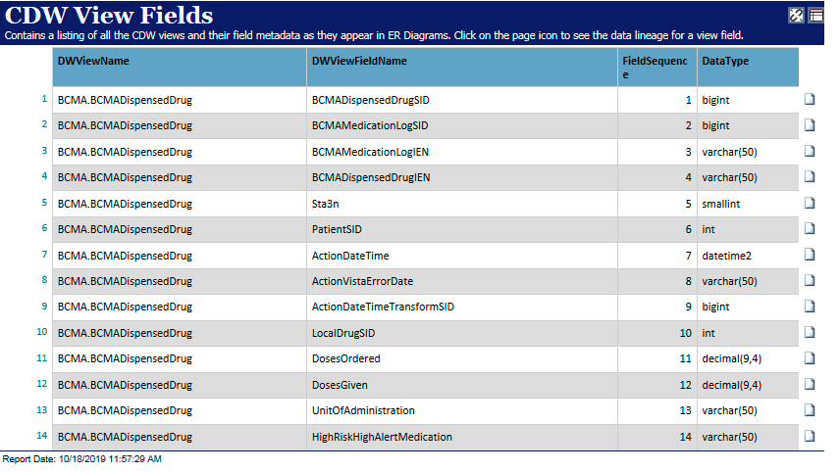
VA CDW Pharmacy Data—BCMA
Dispended Drug
Selected BCMA.DispensedDrug

Slide 42
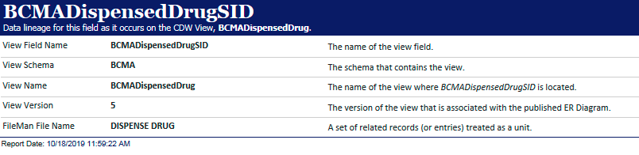
VA CDW Pharmacy Data—BCMA
Dispended Drug
Selected BCMA.DispensedDrug.BCMADispensedDrugSID

Slide 43
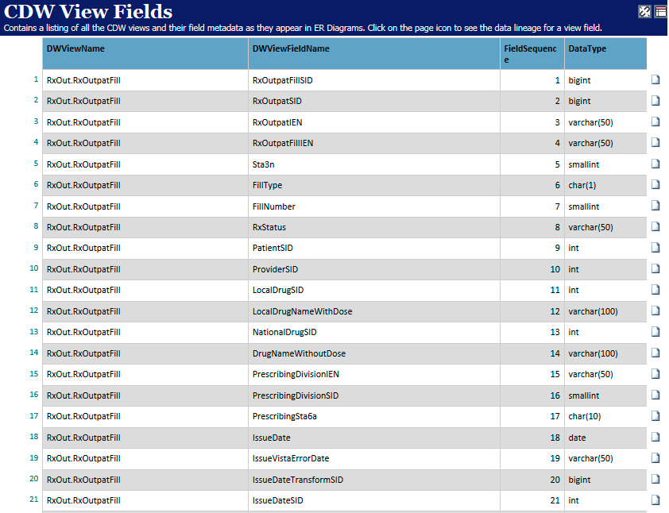
VA CDW Pharmacy Data—Outpatient
Pharmacy Outpatient 3.0
RxOut.RxOutPatFill

Slide 44
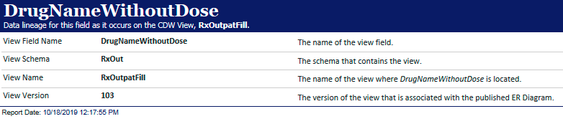
VA CDW Pharmacy Data—Outpatient
Pharmacy Outpatient 3.0
RxOut.RxOutPatFill.DrugNameWithoutdose

